Slide 1
BCOG 100
Spatial Cognition
Lecture 2: Spatial Cognition Algorithms and Representations

Slide 2
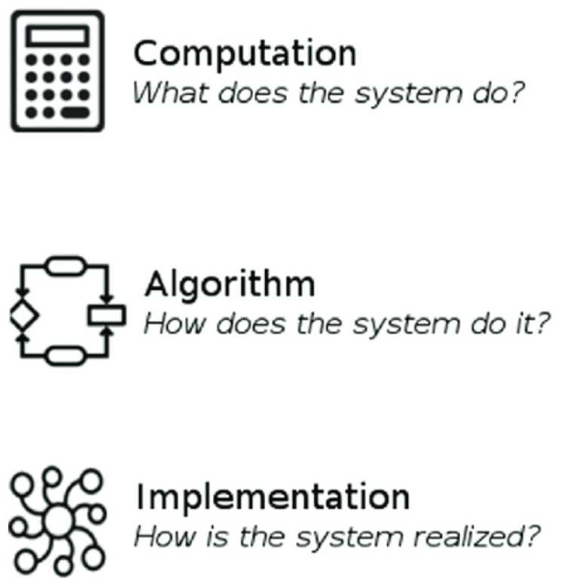
Spatial Cognition Algorithms & Representations
Recap & Overview
Why spatial cognition evolved, and what it allowed early vertebrates to do
Today:
How minds and machines represent and compute space
We’ll draw on both cognitive psychology and machine learning
Notes:
Last time, we focused on why spatial cognition evolved—what problems it solved for early organisms.
We saw that to navigate effectively, they needed to stabilize perception, track self-motion, build internal maps, and use curiosity to explore new spaces.
Today we shift from the functional to the algorithmic level—how those abilities actually work.
What kinds of internal representations make navigation possible?
What computational steps update those representations as we move through the world?
And what are the tradeoffs between different ways of organizing spatial knowledge?
This lecture takes a dual perspective.
From cognitive psychology, we’ll see how humans encode, transform, and recall spatial layouts—how we build mental maps, use landmarks, and sometimes distort space to make it more manageable.
From machine learning, we’ll look at how similar challenges arise in artificial agents: how they represent position, search for efficient paths, and balance exploration with exploitation.
Both fields address the same questions in different languages.
Cognitive psychology describes the mental representations and behavioral patterns; machine learning formalizes them as algorithms and data structures.
By comparing them, we can begin to see how abstract problems like mapping, planning, and curiosity are solved across both biological and artificial systems.

Slide 3

Spatial Cognition Algorithms & Representations
The Computational Challenge
Given partial, noisy input:
How can an agent maintain an accurate sense of space?
Representation + Update = Navigation
Notes:
At the algorithmic level, spatial cognition can be defined as a problem of representation and updating under uncertainty.
An organism or artificial agent rarely has full information about its environment.
It receives partial, noisy sensory inputs
—visual scenes that change with every movement,
proprioceptive cues that drift over time,
landmarks that may appear or disappear.
Despite this, it must maintain a coherent sense of where things are,
where it is, and how its actions will change those relationships.
That requires two things.
First, a representation of spatial structure —some internal format that captures relationships among locations, landmarks, and the agent’s own position.
Second, an update algorithm that continually adjusts that representation as new sensory data arrive or as the agent moves.
Different species—and different computational models—make different tradeoffs between these components.
Some rely on compact, egocentric codes that reset each time the organism moves.
Others maintain allocentric, world-centered models that can integrate many experiences into a single, stable framework.
This is the level where we start to ask Marr’s “algorithmic” questions:
What information is represented?
In what format?
And by what processes is it transformed and maintained over time?
Today we’ll see that cognitive psychology and machine learning both offer powerful,
but complementary, answers to those questions.

Slide 4
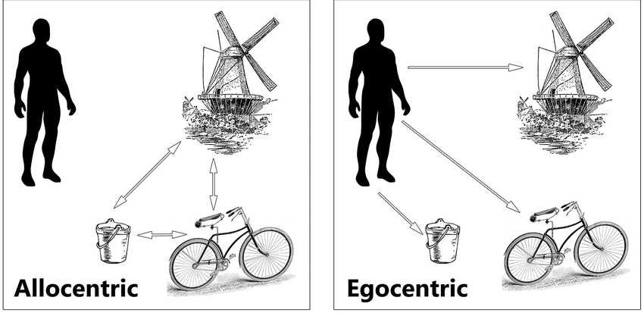
Spatial Cognition Algorithms & Representations
Egocentric and Allocentric Reference Frames
Egocentric: space coded relative to self
Allocentric: space coded relative to environment
Spatial cognition needs both—and transforms between them
Notes:
At the most basic level, there are two fundamentally different ways to represent space.
An egocentric representation codes locations relative to the self
—“the tree is to my left,” “the door is behind me.”
An allocentric representation, by contrast, codes locations relative to other features in the environment
—“the tree is west of the door,” or “the café is across the street from the library.”
Both formats are essential, and each has strengths and weaknesses.
Egocentric coding is fast and useful for immediate action
—it’s how you reach for your coffee cup or steer around an obstacle.
But it’s unstable: every time you move, the frame of reference shifts, and all those relationships must be recomputed.
Allocentric coding, on the other hand, is stable across movement.
It preserves relationships among objects even when you change position.
It’s what allows you to return to a parking spot hours later or imagine how to walk from your house to the library without moving at all.
Cognitive psychology has shown that humans routinely switch between these frames.
Experiments by Mary Hegarty, Barbara Tversky, and Tim McNamara show that our mental representations of space are often a hybrid:
we store stable allocentric relationships, but when we recall or act, we retranslate them into egocentric coordinates.
For navigation, the brain must constantly transform between these two perspectives—updating its internal map as the self moves, and predicting what the world should look like from the new viewpoint.
These transformations form the foundation for all higher-level spatial reasoning.

Slide 5
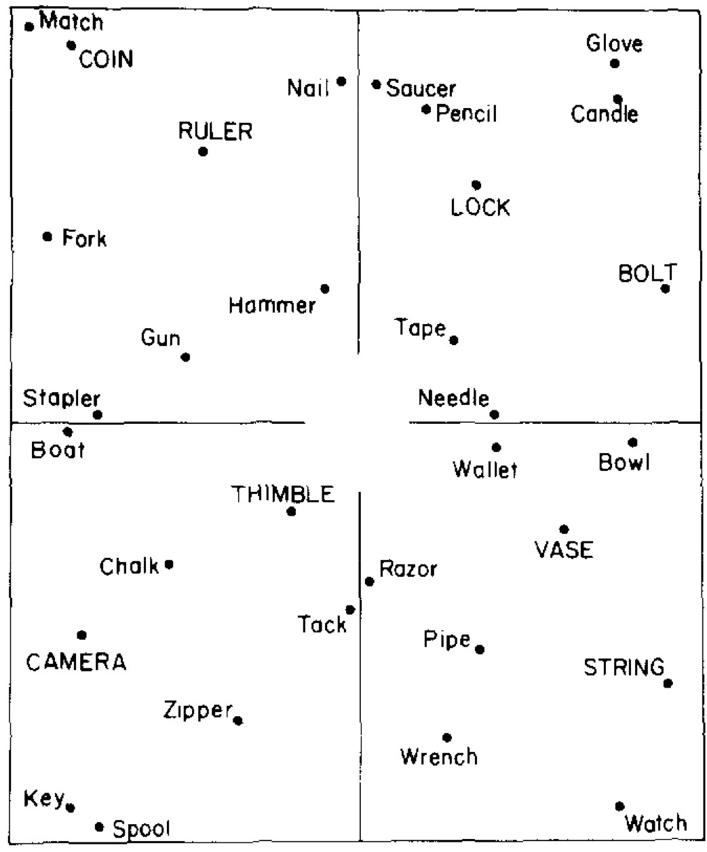
Spatial Cognition Algorithms & Representations
Transforming Between Frames
Mental maps often align with environmental axes
Changing perspective slows recall and increases errors
Reveals the cost of transforming between frames
Notes:
One of the clearest demonstrations of how we transform between egocentric and allocentric frames
comes from work by Barbara Tversky and Tim McNamara.
They asked participants to learn the layout of objects in a room or on a map
—say, where a chair, lamp, and table were arranged relative to one another.
After learning, people were asked to imagine standing at one location, facing another, and then point to a third.
Here’s what they found: when the imagined facing direction matched the original orientation
in which the layout was learned, people responded quickly and accurately.
But when they had to imagine turning to a new direction, response times increased and accuracy dropped.
In other words, their internal map wasn’t purely egocentric
—it was stored in an allocentric reference frame aligned with the room’s or map’s main axes.
When they mentally changed orientation, they had to transform that map back into an egocentric frame,
and that took time and computation.
This shows that even when we think we’re just “remembering where things are,”
we’re actually performing complex geometric operations in our heads
—rotating, translating, and realigning mental coordinates.
The brain seems to anchor its spatial memory to stable environmental axes,
then dynamically recalculate relationships when our point of view shifts.
Those transformation costs—longer reaction times, more directional errors
—reveal the algorithmic workload behind what feels like effortless navigation.

Slide 6
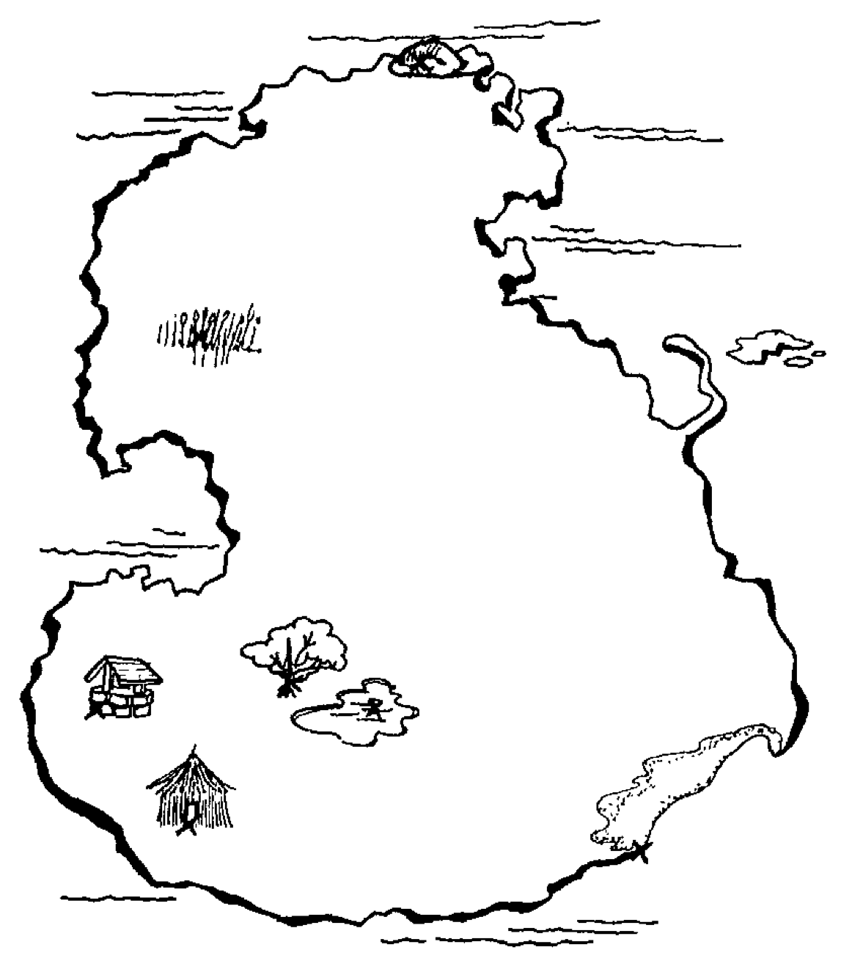

Slide 7
Reading Check 8-2
Password: map
Question: how did you go about recreating the map?

Slide 8
Spatial Cognition Algorithms & Representations
What Form Do Mental Representations Take?
Are mental maps pictorial or propositional?
Kosslyn: Mental images are depictive, like inner pictures
Pylyshyn: Mental images are propositional, abstract descriptions
How we represent space changes what we can compute
Pictorial Representation
Propositional
Representations
tree is next to pond
well and hut are in the SW
island is shaped like a fat-bottomed ”S”
beach is in the SE
E is pretty empty
Notes:
Once we accept that humans store information about space, the next question is: in what format?
Do we keep a kind of internal picture of the world, or do we store abstract descriptions
—something more like sentences in the head?
This became the center of the visual imagery debate between Stephen Kosslyn and Zenon Pylyshyn in the 1970s and 1980s.
Kosslyn argued for what he called a depictive format.
According to him, when you picture a map,
or a familiar object like your living room,
your mind actually represents the spatial layout in something like an image-like medium.
Distances and directions are preserved, so that when you “look around” in your imagination.
It’s as if you’re scanning a real visual field.
In his classic experiments, participants memorized a map with several landmarks
—say, a hut, a tree, and a lake.
When asked to imagine the map and “mentally travel” from the hut to the lake,
their response times increased with distance: longer imagined journeys took longer to report.
Kosslyn saw this as evidence that people were literally scanning across a spatial image in the mind, not consulting abstract facts.
Pylyshyn disagreed.
He argued that mental imagery only feels pictorial but is really propositional
—made up of abstract statements like “the tree is north of the hut,” “the lake is east of the tree.”
In that case, scanning time isn’t due to traversing a picture
—it’s due to mentally accessing information in a structured list or database.
In other words, participants simulate the idea of distance:
they take longer because they know the landmarks are farther apart,
not because their mind’s eye is actually traveling between them.

Slide 9
Spatial Cognition Algorithms & Representations
What Form Do Mental Representations Take?
Are mental maps pictorial or propositional?
Kosslyn: Mental images are depictive, like inner pictures
Pylyshyn: Mental images are propositional, abstract descriptions
How we represent space changes what we can compute
Pictorial Representation
Propositional
Representations
tree is next to pond
well and hut are in the SW
island is shaped like a fat-bottomed ”S”
beach is in the SE
E is pretty empty
Notes:
Once we accept that humans store information about space, the next question is: in what format?
Do we keep a kind of internal picture of the world, or do we store abstract descriptions
—something more like sentences in the head?
This became the center of the visual imagery debate between Stephen Kosslyn and Zenon Pylyshyn in the 1970s and 1980s.
Kosslyn argued for what he called a depictive format.
According to him, when you picture a map,
or a familiar object like your living room,
your mind actually represents the spatial layout in something like an image-like medium.
Distances and directions are preserved, so that when you “look around” in your imagination.
It’s as if you’re scanning a real visual field.
In his classic experiments, participants memorized a map with several landmarks
—say, a hut, a tree, and a lake.
When asked to imagine the map and “mentally travel” from the hut to the lake,
their response times increased with distance: longer imagined journeys took longer to report.
Kosslyn saw this as evidence that people were literally scanning across a spatial image in the mind, not consulting abstract facts.
Pylyshyn disagreed.
He argued that mental imagery only feels pictorial but is really propositional
—made up of abstract statements like “the tree is north of the hut,” “the lake is east of the tree.”
In that case, scanning time isn’t due to traversing a picture
—it’s due to mentally accessing information in a structured list or database.
In other words, participants simulate the idea of distance:
they take longer because they know the landmarks are farther apart,
not because their mind’s eye is actually traveling between them.

Slide 10
Spatial Cognition Algorithms & Representations
Hybrid Representations and Modern Parallels
Modern evidence: spatial thinking uses both depictive and propositional codes
Visual and symbolic brain systems cooperate during imagery
Echoes today: the same questions resurface in debates about LLM “world models”
tree next to pond
tree next to pond
Notes:
Modern research suggests that both formats coexist.
Brain imaging shows that visual areas activate during mental imagery, consistent with Kosslyn’s view.
But frontal and parietal regions—associated with symbolic reasoning and relational coding
—also play key roles, consistent with Pylyshyn’s.
Most cognitive scientists now think spatial cognition uses hybrid representations:
depictive formats for tasks that rely on geometry or perception,
and propositional ones for tasks that require abstract reasoning or flexible inference.
The key insight for us is that the format matters.
A pictorial code makes certain computations—like scanning or rotation—fast and natural.
A symbolic code supports logic, hierarchy, and flexible re-description.
Real cognitive systems, biological and artificial, often combine both to get the best of each world.
This old debate has an interesting echo today in arguments about whether large language models have a “world model.”
Ironically, Pylyshyn’s symbolic view
—mental representations as structured propositions
—would seem to fit LLMs best,
since they encode and manipulate relational information in linguistic form.
Yet many of the contemporary critics who favor symbolic theories of mind
now reject LLMs as lacking true understanding,
while those from the more connectionist or empiricist traditions
see them as evidence of emergent, analog-like structure.
It’s a neat reversal: the same philosophical divide reappearing, but the alliances have flipped.

Slide 11
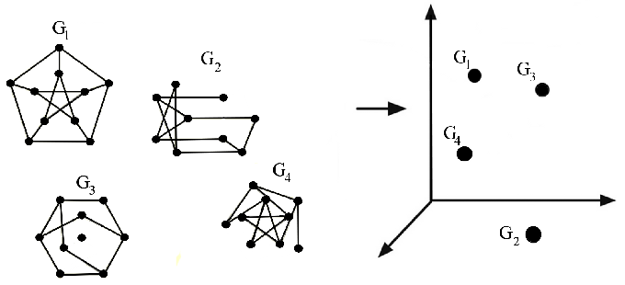
Spatial Cognition Algorithms & Representations
Topological
Metric
Other Candidate Structures
Metric: precise distances and angles
Topological: connectivity without scale
Hierarchical: nested regions and routes
Notes:
Not all internal maps work the same way.
Cognitive psychologists have proposed several different kinds of spatial representations,
each capturing different aspects of the environment.
A metric map encodes exact distances, angles, and coordinates
—like a surveyor’s chart or a GPS readout.
It allows fine-grained geometric computations
but requires constant calibration and is prone to accumulated error.
A topological map, by contrast, focuses on connectivity:
which locations are linked, or what path leads from one to another,
without storing absolute scale or direction.
This type of representation is efficient for route planning—if you know A connects to B and B connects to C, you can still reach C even if you don’t know the exact distance or bearing.
Finally, hierarchical maps group locations into larger clusters
—rooms within a building, neighborhoods within a city.
Research by Barbara Tversky, Herbert Simon, and others shows that people often recall space in this nested way,
which explains many systematic distortions in spatial memory:
we compress distances within a region and exaggerate those between regions.
Each structure trades accuracy for efficiency.
Metric maps are precise but computationally expensive;
topological maps are robust and compact; hierarchical maps help manage complexity.
Real minds—and most robotic systems—combine these forms to balance precision with practicality.

Slide 12
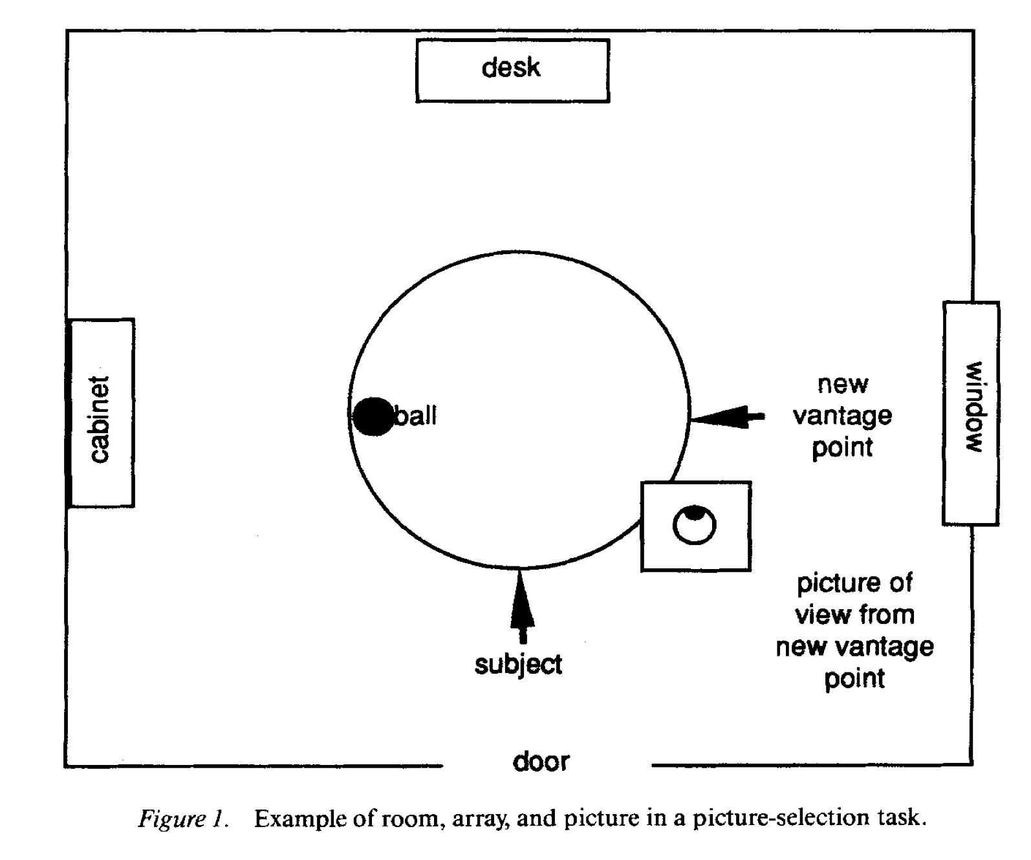
Spatial Cognition Algorithms & Representations
Landmarks and Spatial Hierarchies
Landmarks anchor spatial memory and reduce drift
Children and adults organize space into nested regions
Spatial hierarchies explain many everyday navigation errors
Notes:
In real cognition, these abstract map types show up in how people actually navigate and remember space.
One of the most powerful tools for keeping track of location is the landmark — a stable feature that serves as a reference point.
Even infants use large, distinctive landmarks to orient themselves; and adults rely on them to reset internal estimates when path integration drifts.
When people lose those anchors — for example, in featureless environments — they quickly become disoriented, even if they have a sense of movement direction.
Landmarks also help form spatial hierarchies.
Barbara Tversky and others found that people naturally group locations into regions — “the kitchen area,” “the east side of campus,” “the downtown district.”
We remember within-region relationships well, but distort distances between regions, often assuming they’re farther apart or oriented differently than they really are.
These distortions reveal that our maps are not purely geometric; they’re structured around functional and conceptual boundaries.
Developmental studies by researchers like Nora Newcombe and Janellen Huttenlocher show that children progress through similar stages.
Early on, they navigate using landmarks and simple topological links — “the toy is near the chair.”
Only later do they develop metric accuracy, using distances and angles to integrate those landmarks into a unified frame.
In short, both children and adults build hierarchical, landmark-based maps that trade exact geometry for conceptual organization — an efficient compromise that works remarkably well for everyday navigation.

Slide 13

Spatial Cognition Algorithms & Representations
Path Integration and Updating Mechanisms
Integrating self-motion to estimate position
Errors accumulate without external cues
Brains and machines use feedback to recalibrate
Notes:
Consider some of these situations:
Driving in dense fog or a blizzard – Visual cues vanish, and even small steering adjustments accumulate error. Drivers may veer off course without realizing it.
Walking through a crowded room or concert – You move based on local avoidance cues, but landmarks are blocked or moving, so your sense of global orientation degrades.
Swimming underwater or diving – Gravity cues and visual horizons disappear; proprioceptive and vestibular feedback can conflict, causing disorientation.
In each case, what’s gone wrong is feedback.
Your brain is still tracking motion, but it’s doing it in isolation —integrating tiny velocity signals to estimate position.
That process is called path integration, and it’s how both animals and machines
keep track of where they are when external cues are missing.
Path integration combines signals from the body—vestibular information about rotation,
proprioceptive feedback from limbs, and visual flow when available—to continuously update location.
But every signal carries noise.
As those errors accumulate, the internal estimate drifts,
and the map no longer matches the world.
That’s why, after a few turns in the dark, you can end up
facing the wrong way or several meters off course without realizing it.
Both biology and robotics face the same problem.
Robots relying on inertial sensors show the same drift humans do,
unless they periodically correct with external landmarks or environmental feedback.
Algorithms like Kalman filters or SLAM systems implement this correction explicitly
—just as the brain recalibrates its map whenever stable reference points reappear.
Whether in fog, crowds, or open water, the rule is the same:
navigation depends not just on integrating movement,
but on continually anchoring those estimates to the outside world.

Slide 14
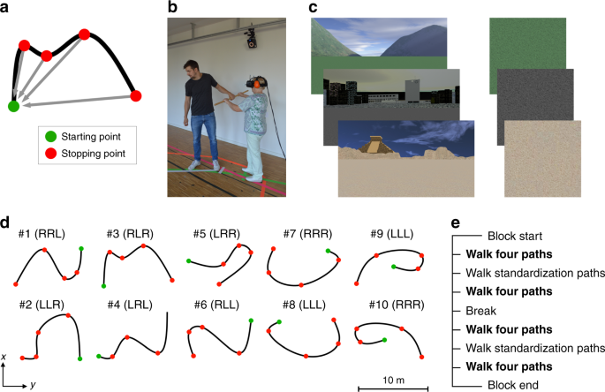
Spatial Cognition Algorithms & Representations
Human and Animal Evidence for Path Integration
Many species track position by integrating motion
Errors grow with distance and rotation
External cues reset and stabilize internal estimates
Notes:
Path integration isn’t unique to humans
— it’s one of the most ancient and widespread navigation strategies in the animal kingdom.
Desert ants, for example, leave their nests and wander randomly while foraging,
sometimes over hundreds of meters.
When they find food, they don’t retrace their exact steps.
Instead, they turn and walk almost directly back to the nest in a straight line,
using an internal estimate of distance and direction built up during the outbound path.
But the longer or more circuitous the route, the larger the error on the return
—showing the slow accumulation of drift in their internal sum of movements.
Humans show the same pattern.
In laboratory tasks where people walk blindfolded along a path
and then try to return to the start, small errors add up quickly.
A few extra degrees of rotation or a misjudged stride length
are enough to create large position errors after just a few steps.
Adding auditory or visual landmarks immediately improves accuracy,
because those external cues reset the internal estimate.
Studies in rats, bats, and even fish have found neural evidence of similar mechanisms.
Specialized cells in the hippocampus and surrounding areas track heading, distance, and displacement
— essentially integrating self-motion signals into a continuous location estimate.
Across species, the pattern is the same:
path integration provides a powerful but fallible system for keeping track of where you are.
It works best when the world provides stable cues for periodic recalibration.

Slide 15
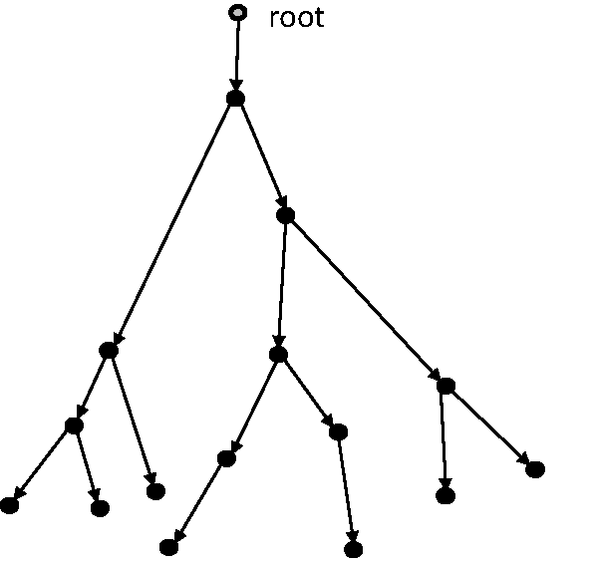
Spatial Cognition Algorithms & Representations
Exploration and the Value and Cost of Novelty
Once you have a map, the question changes: where next?
Exploration adds information and reduces uncertainty
Novelty itself can be intrinsically rewarding
-3
+8
-7
+9
+7
-5
+2
Notes:
Up to now, we’ve talked about how organisms build and update maps of space
—how they maintain orientation, track movement, and correct drift.
But once an organism has a stable map, a new question arises: where should it go next?
Exploration serves a different purpose than navigation.
Navigation is about reaching known goals efficiently;
exploration is about discovering what you don’t yet know.
Each movement into unfamiliar territory adds information
—about new landmarks, new food sources, or new dangers
—and helps refine the map for future use.
Interestingly, exploration isn’t only instrumental.
Across species, animals seem to find novelty itself rewarding.
Rats investigate new corridors even when no food is there.
Human infants stare longer at new shapes or patterns than familiar ones.
This drive toward novelty helps fill in the spatial map and reduces uncertainty about the environment.
You can think of it as the cognitive version of curiosity
—a motivational system that pushes an organism to keep learning,
even when there’s no immediate payoff.
Once maps exist, curiosity becomes a way of improving them,
making future navigation—and future decisions—more efficient.

Slide 16
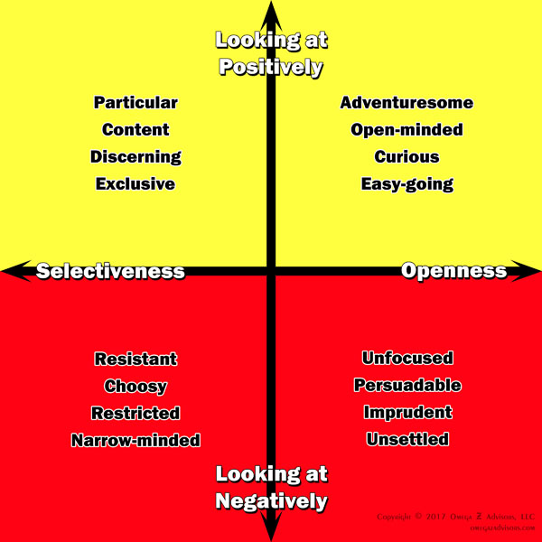
Spatial Cognition Algorithms & Representations
The Explore–Exploit Tradeoff
Explore: gain new information
Exploit: use what you already know
Every organism—and every AI—must balance the two
Notes:
Exploration is valuable, but it’s also costly.
Time spent exploring is time not spent exploiting known rewards.
This creates one of the most fundamental dilemmas in both biology and decision theory
—the explore–exploit tradeoff.
Organisms face it constantly.
Do you keep foraging in a field you know has food,
or venture into the unknown in case there’s something better?
Do you try a new route home that might be faster, or stick with the one you know works?
In humans, even small choices—trying a new restaurant, clicking an unfamiliar link
—reflect the same tension between curiosity and safety.
Too much exploitation leads to rigidity—you stop learning and fail to adapt when conditions change.
Too much exploration leads to inefficiency—you keep searching and never settle on a good solution.
Adaptive behavior lies somewhere in between.
Psychologists study this in both animals and people, showing that novelty, uncertainty,
and reward history all shape how organisms shift between modes.
Machine learning faces the same challenge:
reinforcement-learning agents must decide when to stick with a high-value option
and when to gather new information.
Whether in a rat maze or an AI’s search space, the goal is the same
—to balance using knowledge and gaining knowledge so that long-term success is maximized.

Slide 17
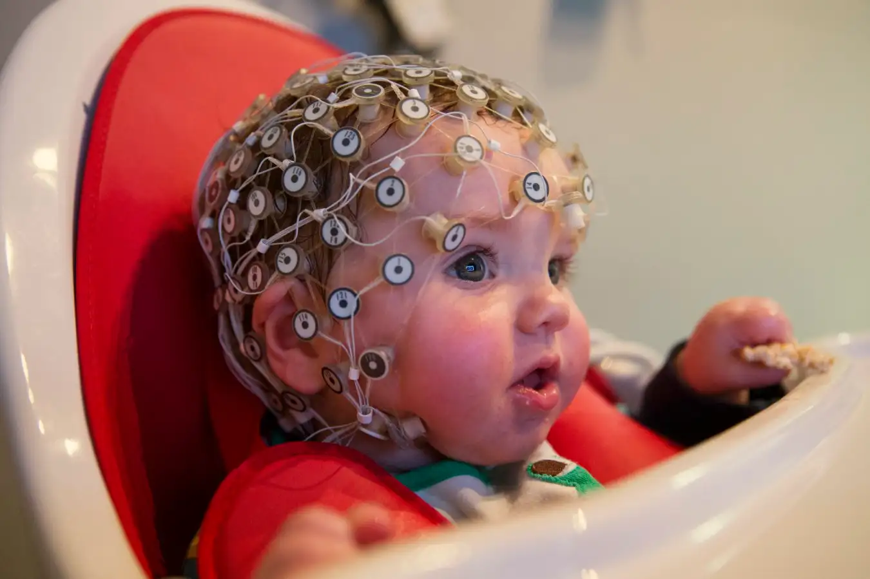
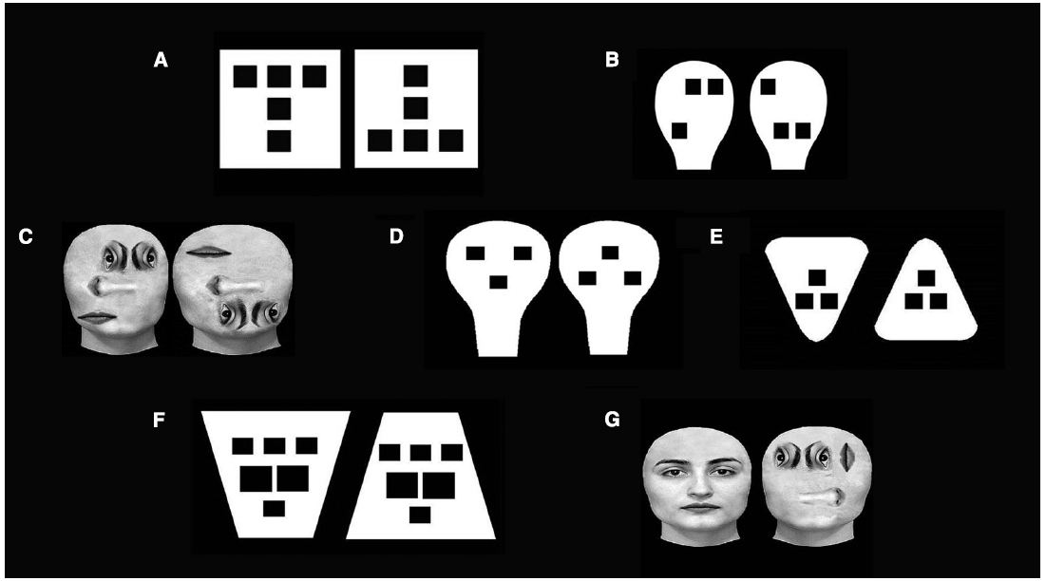
Spatial Cognition Algorithms & Representations
Curiosity and Intrinsic Motivation
Exploration can be rewarding on its own
Curiosity reduces uncertainty and builds knowledge
Play is nature’s way of learning without stakes
Notes:
Exploration isn’t always about finding food or avoiding danger.
Across species, animals explore even when there’s nothing obvious to gain
— suggesting that the act itself is rewarding.
This is the idea of intrinsic motivation: the drive to seek information, novelty, or mastery for its own sake.
Psychologists have studied this under many names
— curiosity, play, sensation-seeking, and epistemic motivation
— but the basic pattern is the same.
Organisms are drawn to situations where they can learn the most,
especially when those situations are neither too easy nor too hard.
Infants, for example, spend more time looking at moderately novel stimuli
than at familiar or completely incomprehensible ones.
This preference helps them sample experiences that are maximally informative.
From a functional standpoint, curiosity reduces uncertainty.
Exploration expands the internal map and makes future behavior more efficient and adaptable.
And from a developmental standpoint, play serves a similar role.
Through play, young animals and humans practice actions, test boundaries,
and learn about causal relationships in a low-risk setting.
In this sense, curiosity is not a luxury—it’s a learning algorithm.
It motivates organisms to seek experiences that improve their internal models of the world,
even when no immediate reward is present.

Slide 18
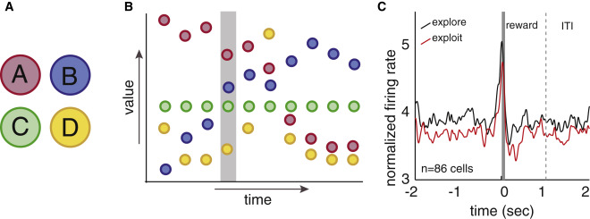
Spatial Cognition Algorithms & Representations
Explore–Exploit in Human and Animal Studies
Exploration peaks in youth, but persists across life
Animals and humans explore strategically, not randomly
Curiosity adapts to uncertainty and potential reward
Notes:
Both humans and other animals face the same challenge: deciding when to explore and when to exploit.
And research shows that exploration isn’t random—it’s strategic, tuned to uncertainty, risk, and expected information gain.
In human development, curiosity and exploration peak in childhood.
Children sample new actions, test causal relationships, and deliberately seek out surprising outcomes.
Studies by Kidd and Hayden, and Gottlieb and Oudeyer,
show that both children and animals prefer situations that are just uncertain enough
—where new information is most likely to be gained.
This “Goldilocks” zone of curiosity maximizes learning efficiency.
Exploration doesn’t disappear in adulthood, but it becomes more selective.
Adults rely more on accumulated knowledge,
but they still increase exploration when environments change or rewards become unpredictable.
Similar patterns appear in other species: birds, primates, and even fish
modulate exploration depending on novelty, prior experience, and energetic cost.
Across species and ages, exploration reflects an adaptive balance:
it’s the mechanism that keeps organisms flexible in uncertain worlds.

Slide 19
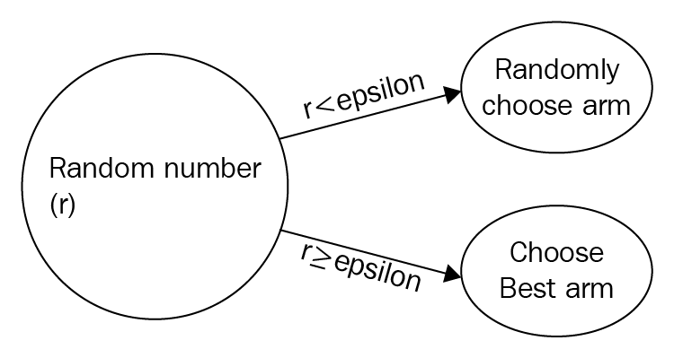
Spatial Cognition Algorithms & Representations
Explore–Exploit in Machine Learning
AI agents face the same problem
Too little exploration: they get stuck
Too much: they never learn what works
Notes:
The same tradeoff we’ve been discussing also appears in artificial systems.
Reinforcement-learning agents—like those that learn to play games or control robots
—have to decide when to explore new actions and when to exploit what they’ve already learned.
If they exploit too early, they might lock into a decent but not optimal strategy
—like a forager who keeps returning to one patch of berries because it worked once.
If they explore too much, they waste time trying more options instead of improving performance.
Most learning algorithms handle this by mixing the two.
A simple example is the “ε-greedy” rule:
most of the time, the agent picks the best-known option, but occasionally
—say 10% of the time—it tries something new.
More advanced systems adjust that balance dynamically,
exploring more when they’re uncertain and less as they learn.
In other words, AI systems face the same adaptive logic that evolution discovered long ago.
They learn best when curiosity and caution coexist
—when exploration is guided by uncertainty and balanced by experience.

Slide 20
Spatial Cognition Algorithms & Representations
Recap
There are many kinds of maps we can have
There are many algorithms for integrating them with input
Curiosity as a mechanism for building maps
Up Next
How brains implement those computations—From spatial maps to memory systems
Notes:
Last time, we asked why spatial cognition evolved
—what problems it solved for early organisms trying to navigate and predict their surroundings.
Today, we’ve looked at how those problems can be solved algorithmically.
We saw that cognitive psychology and machine learning both converge on a similar story:
we can see that spatial cognition isn’t just about knowing where things are.
It’s an entire algorithmic system for learning and adapting to the world.
Spatial maps provide structure — a framework for representing the relationships among places, actions, and outcomes.
Curiosity supplies the motivation to fill in that structure, to seek out the missing pieces and test predictions.
And exploration manages the balance — when to gather more information and when to use what’s already known.
Together, these mechanisms let organisms and machines move from reactive behavior to model-based reasoning.
They don’t just respond to stimuli; they use internal representations to plan, imagine, and simulate future outcomes.
In cognitive terms, this means learning shifts from trial and error to model building.
In computational terms, it marks the transition from model-free to model-based learning
— systems that can anticipate consequences before acting.
This is where navigation turns into something deeper: prediction, planning, and even imagination.
And as we’ll see next time, the neural architecture that evolved to support spatial mapping in early vertebrates
— especially the hippocampus and surrounding systems — later became the foundation for memory itself.
Next time, we’ll move to the neural level—to see how real brains implement these computations.
We’ll explore how the hippocampus, entorhinal cortex, and related systems create spatial maps, predict future paths, and replay experiences.
And we’ll end by tracing how these same neural systems laid the groundwork for one of the brain’s most powerful capacities: memory itself.

